Slide 1

SMART INDIA HACKATHON 2026
Hallucination-Resistant Multimodal Socratic Tutor
Problem Statement ID – SIH26207
Problem Statement Title- Student Innovation-Smart education
Theme- Smart Education
PS Category- Software
Team ID-
Team Name – Jura Tempest

Slide 2
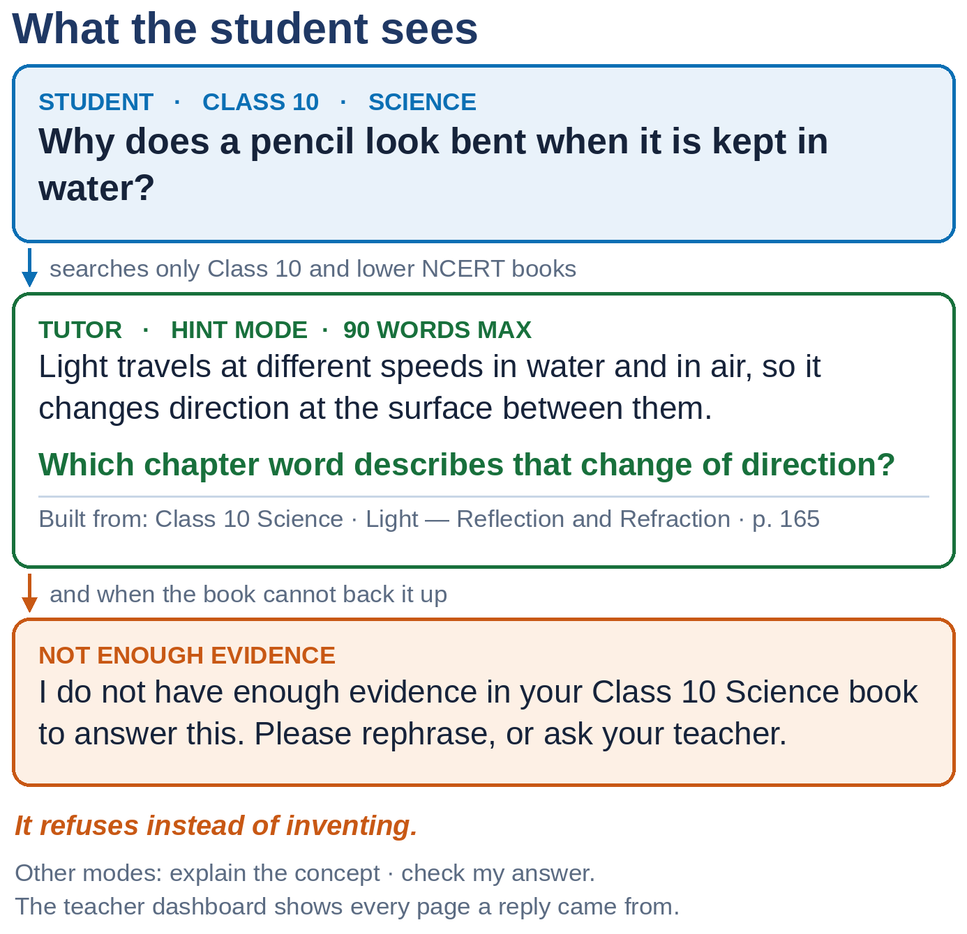
IDEA TITLE
Jura
Tempest
Proposed Solution:
Detailed Explanation:
An offline doubt-solving tutor for students across different classes and subjects, grounded in a defined curriculum.
The selected curriculum is transformed into a structured knowledge graph — from chapters to pages, sections and chunks — while preserving relevant figures.
A student selects their class and subject, then types a doubt or uploads a photo of the question.
The system retrieves relevant data from the curriculum, checks whether the evidence is sufficient, and only then generates a response.
How it addresses the problem:
Every reply is built from retrieved data, so it stays inside the syllabus and at the student’s own class level.
If the book does not back the doubt, the tutor says so instead of inventing an answer.
A teacher can open the dashboard and see exactly which data a reply came from.
Innovation and uniqueness of the solution:
It teaches instead of answering: one hint and one guiding question, with separate modes to explain a concept or check the student’s own attempt.
Before answering, the system checks whether the retrieved evidence is relevant and strong enough; otherwise, it stops rather than generate an unsupported response.
One database does all three searches — meaning, exact words and chapter structure — merged by weighted Reciprocal Rank Fusion.
Weighted Reciprocal Rank Fusion : score(chunk) = (Σ for all channels) weight_channel / (k + rank_channel)
Retrieval is class-aware: this class and lower classes only, never above.
Maths-based “is my answer right?” checks are verified with SymPy, not left to the model.
Everything runs on one machine, and student photos are deleted after the query.

Slide 3
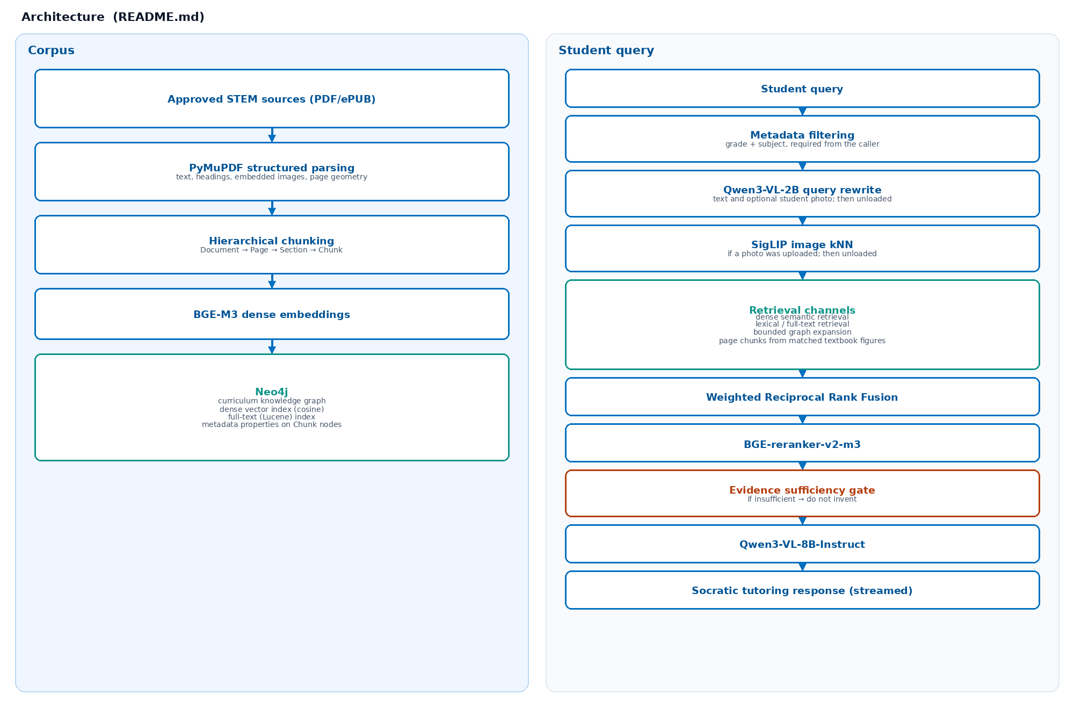
TECHNICAL APPROACH
Jura Tempest
2. Technologies Used:
Data & Retrieval: Python + PyMuPDF for NCERT parsing → hierarchical Document/Page/Section/Chunking → BGE-M3 embeddings → Neo4j Knowledge Graph with cosine Vector + Lucene Full-Text indexes → Hybrid Retrieval + Weighted RRF + BGE-Reranker-v2-m3. AI & Application: Qwen3-VL-2B for query rewriting/photo understanding + SigLIP for figure matching → Evidence Sufficiency Gate → Qwen3-VL-8B-Instruct for Socratic tutoring → FastAPI + React/Vite + Cytoscape for local observability → SymPy for mathematical verification.
3. Methodology:
NCERT Parsing: PyMuPDF → Document → Page → Section → Chunk
Knowledge Base: BGE-M3 embeddings → Neo4j Graph + Vector + Lucene indexes
Query Processing: Grade/Subject filtering → Qwen3-VL-2B rewrite → SigLIP for images
Hybrid Retrieval: Dense + Lexical + Graph + Figure retrieval → Weighted RRF
Evidence Check: BGE Reranker → Grade-aware selection → Evidence Sufficiency Gate
Tutoring: Qwen3-VL-8B → Structured & validated Socratic response

Slide 4
FEASIBILITY AND VIABILITY
Jura Tempest
IT ALREADY WORKS
The full pipeline runs end to end today - ingest, retrieve, gate, tutor, dashboard. Every part is free and open: Python, Neo4j Community, open-weight models. The data is free and official - complete-book zips from ncert.nic.in, with SHA-256 recorded. Models are loaded, used, then released, so a modest GPU is enough. Nothing needs a network, so a school lab PC is enough.
WHAT COULD GO WRONG
On a small GPU some layers sit in RAM, so a reply can take a while. The evidence-gate thresholds are heuristics - they are not validated yet. We have no retrieval accuracy numbers, because no labelled question set exists. Section titles are noisy - page furniture is sometimes read as aheading.
HOW WE HANDLE IT
A hardware-aware loader splits weights between GPU and RAM and frees each model after use. Build a labelled question set, then tune the gate against Recall@K, MRR and nDCG. Fall back to page and chapter lineage instead of trusting section titles.

Slide 5
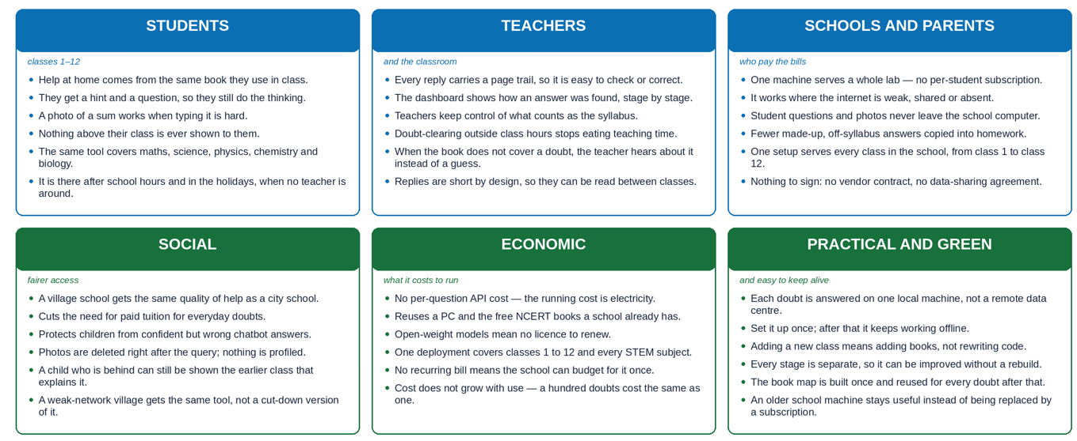
IMPACT AND BENEFITS
Jura Tempest

Slide 6
RESEARCH AND REFERENCES
Jura Tempest
Details / Links of the reference and research work
Curriculum source
NCERT textbooks, classes 1–12, official English editions — https://ncert.nic.in/textbook.php · the only corpus we ingest; complete-book zips, with a SHA-256 manifest kept in the repository.
Why a tutor, and why grounding matters
B. S. Bloom (1984), “The 2 Sigma Problem: The Search for Methods of Group Instruction as Effective as One-to-One Tutoring”, Educational Researcher 13(6), 4–16.
Z. Ji et al. (2023), “Survey of Hallucination in Natural Language Generation”, ACM Computing Surveys 55(12) — arXiv:2202.03629.
Retrieval and fusion
P. Lewis et al. (2020), “Retrieval-Augmented Generation for Knowledge-Intensive NLP Tasks”, NeurIPS — arXiv:2005.11401.
G. Cormack, C. Clarke and S. Buettcher (2009), “Reciprocal Rank Fusion Outperforms Condorcet and Individual Rank Learning Methods”, SIGIR — doi:10.1145/1571941.1572114.
D. Edge et al. (2024), “From Local to Global: A Graph RAG Approach to Query-Focused Summarization” — arXiv:2404.16130.
Models we run locally
J. Chen et al. (2024), “M3-Embedding” (BGE-M3) — arXiv:2402.03216 · S. Xiao et al. (2023), “C-Pack” (BGE rerankers) — arXiv:2309.07597.
X. Zhai et al. (2023), “Sigmoid Loss for Language Image Pre-Training” (SigLIP), ICCV — arXiv:2303.15343.
Qwen Team (2025), “Qwen3-VL Technical Report” — arXiv:2511.21631 · https://github.com/QwenLM/Qwen3-VL.
Tools and our own work
Neo4j vector indexes and full-text search — https://neo4j.com/docs · PyMuPDF — https://pymupdf.readthedocs.io · SymPy — https://www.sympy.org
Project repository and full technical README — https://github.com/Nnik345/sih-stem-rag

